Slide 1
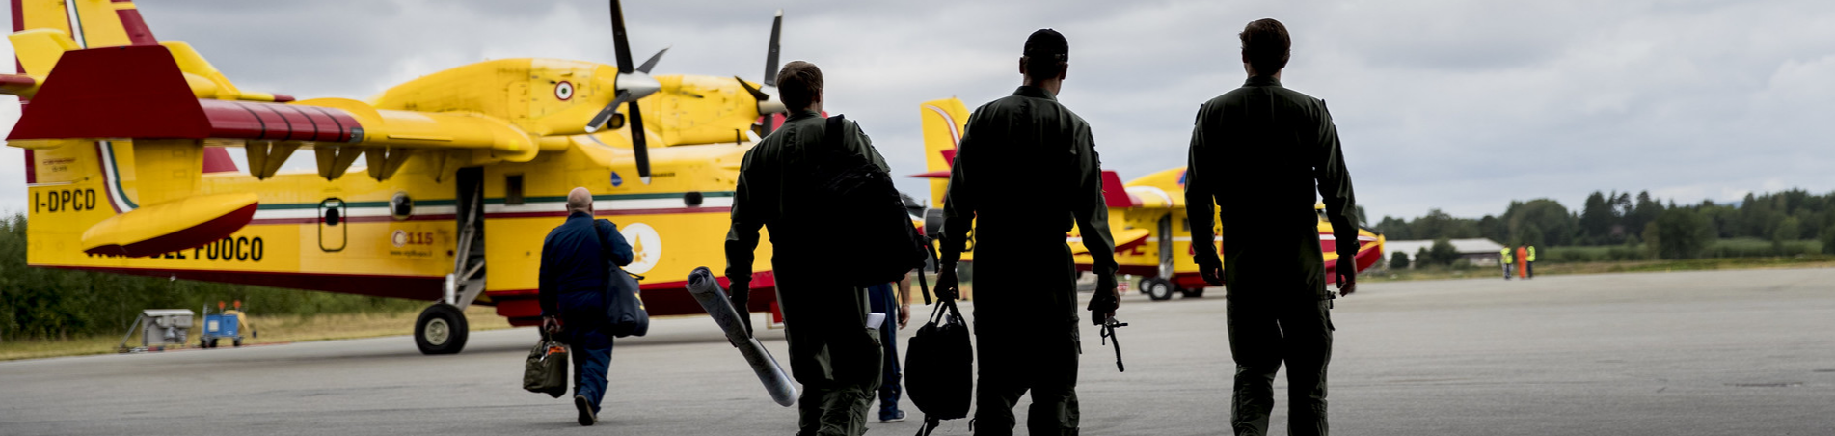
EU Preparing for the 2023 wildfire season
#rescEU #EUCivilProtection

Slide 2

Emergency Response Coordination Centre (ERCC)

Slide 3




The ERCC, launched in May 2013, improves coordination between civil protection and humanitarian aid operations and
maintains a direct link to civil protection authorities and humanitarian aid organisations
in EU Member States enabling real-time exchange of information
Monitors disasters
around the globe
Maps disaster
risks
Provides real-time
information
Coordinates joint European
response operations
Notes:
Ensures the deployment of coordination and assessment teams composed of humanitarian aid and civil protection experts to
conduct joint needs assessment

Slide 4
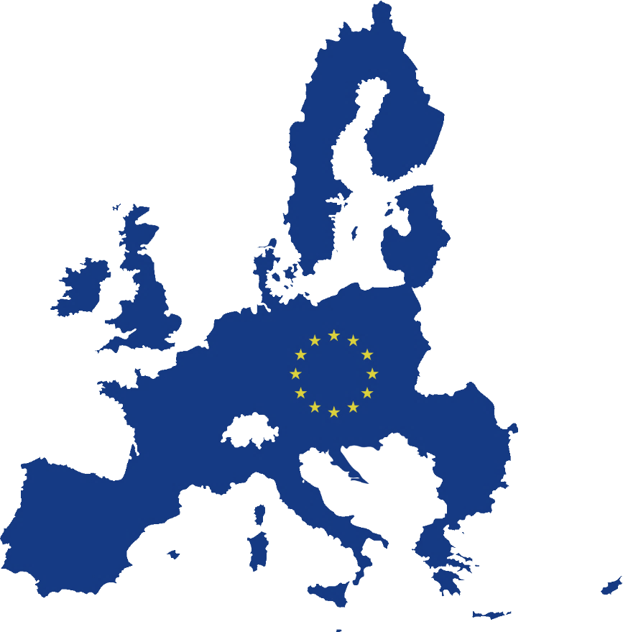









When an emergency overwhelms national response capacities, the EU Civil Protection Mechanism enables a coordinated assistance by
all EU Member States
9 Participating States

Slide 5
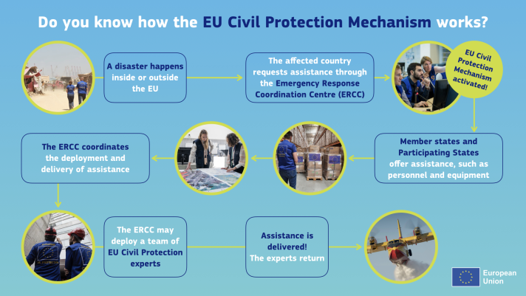

Slide 6
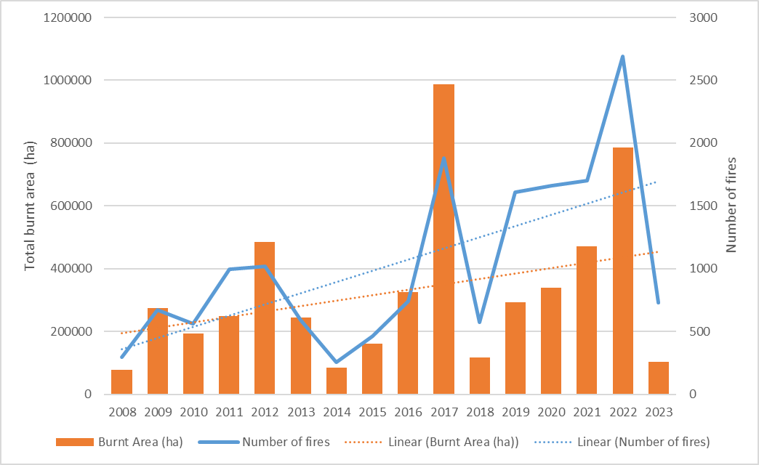
Burnt areas and number of fires in the EU
Amount of burnt areas and number of events recorded by EFFIS since 2008.
Notes:
The trend in the number of wildfires and burnt areas in the EU during the last 15 years indicates that
the most critical years in this period were 2012, 2017 and 2022 (Fig. 2), coincidentally occurring every
five years. These specific years were characterized by the presence of very large wildfires that affected
large areas in the Mediterranean region.

Slide 7
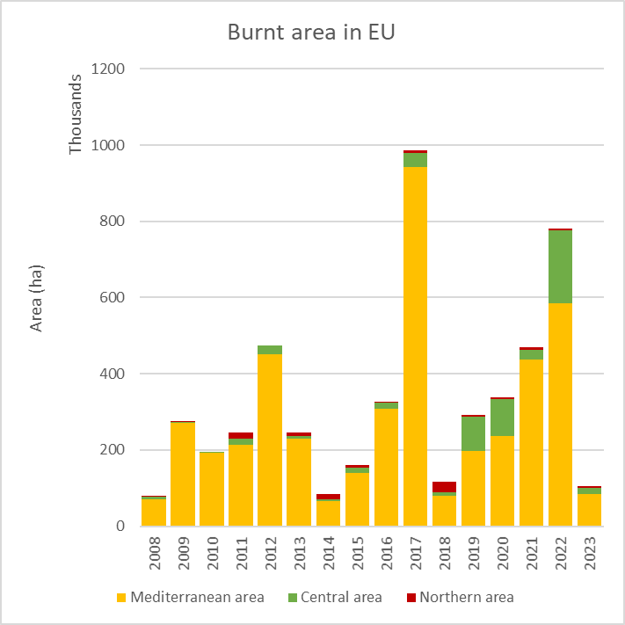
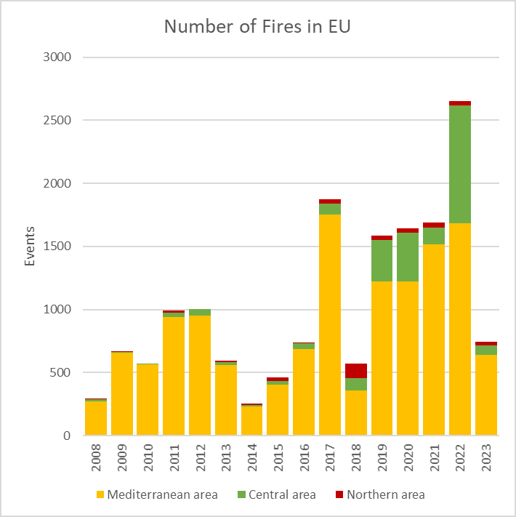
Burnt areas and number of fires in the EU
Total burnt area and number of events recorded by EFFIS since 2008 by year and region.
Notes:
2017 was characterized by very large wildfires in the Mediterranean region; it was the worst year in
the history of the EU, with over 130 people killed by fires and a burnt area around one million ha. This
triggered the discussion and revision of the Union Civil Protection Mechanism (UCPM).
2018 was characterized by a high number of wildfires in central and northern Europe, especially in
Sweden, which required the support of other EU countries through the EU Civil Protection mechanism.
2019, 2020, 2021 and 2022 showed an increase of burnt areas and number of wildfires in central
Europe, and a new pattern with a very high number of winter and spring wildfires; 2023 is confirming
this pattern again

Slide 8
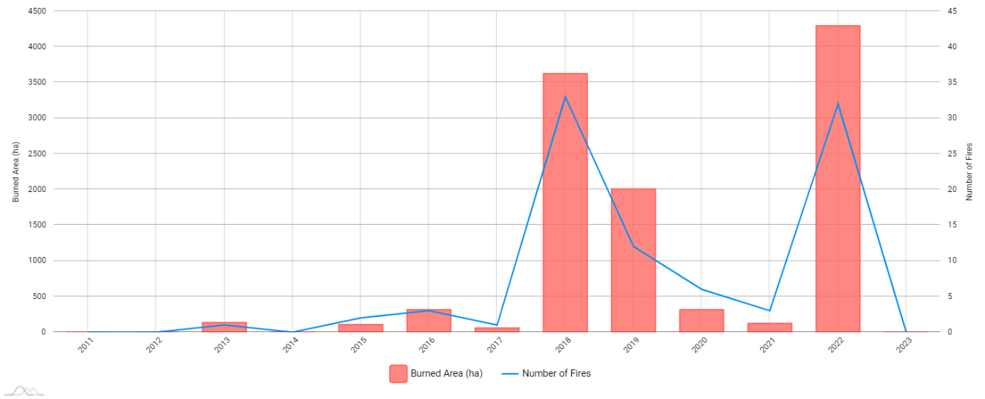
Burnt areas and number of fires in DE

Slide 9
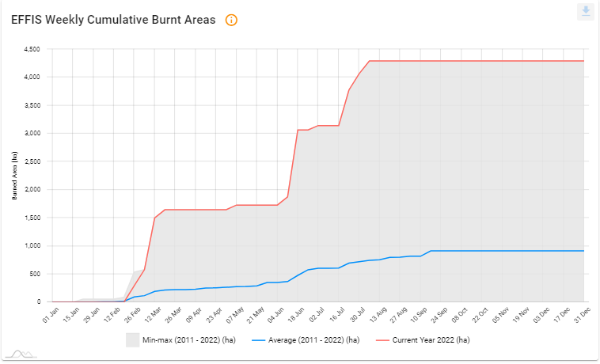
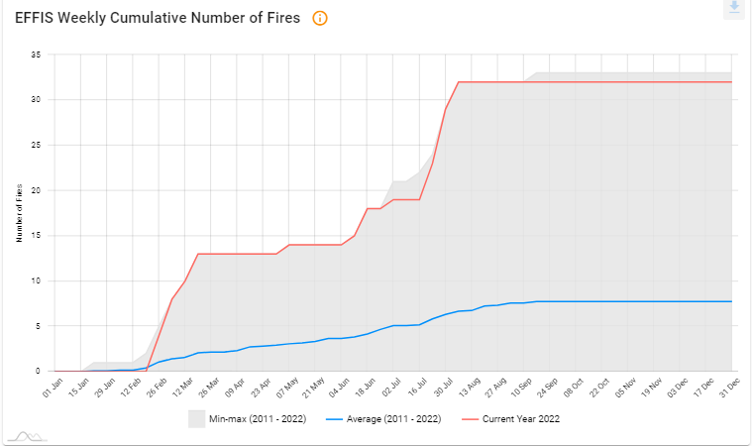
2022 burnt area and number of fires in DE
Germany - 2022 burnt areas and number of fires
Notes:
DE: Following the general trend it was experienced far above average burnt areas and number of fires in 2022. Actually, it was the worst year in terms of burnt areas and number of fires since 2010.

Slide 10
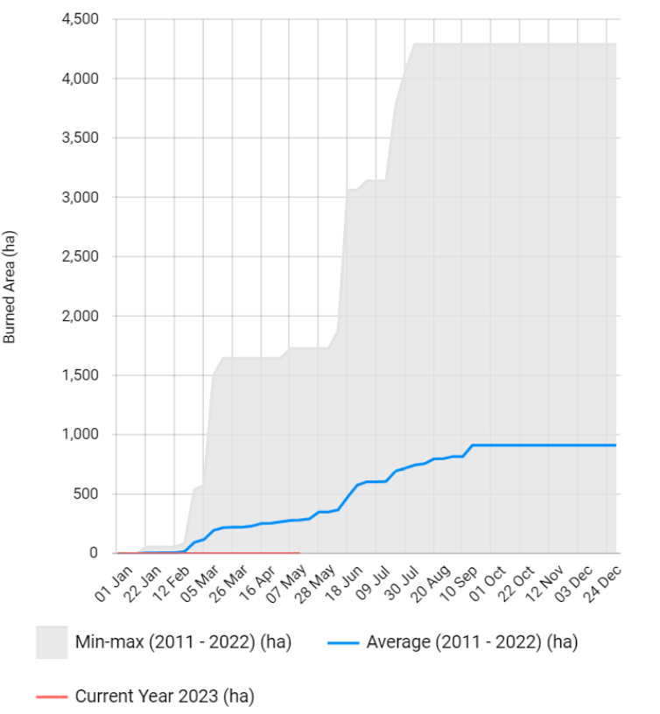
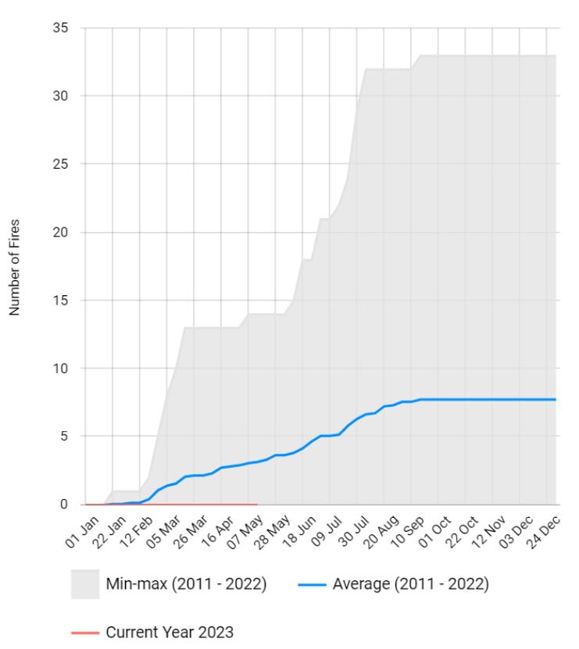
2023 burnt area and number of fires in DE
Germany – 2023 (until 14 May) burnt areas and number of fires
Notes:
DE: From 1 January until mid February the total burnt area and the number of wildfire events were around the average. Since March until 14 May 2023, are below the average.

Slide 11
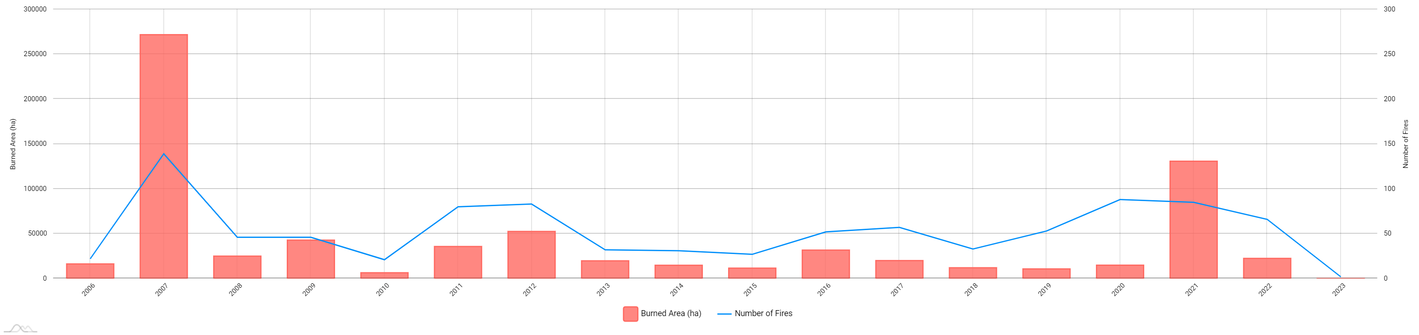
Burnt areas and number of fires in EL

Slide 12
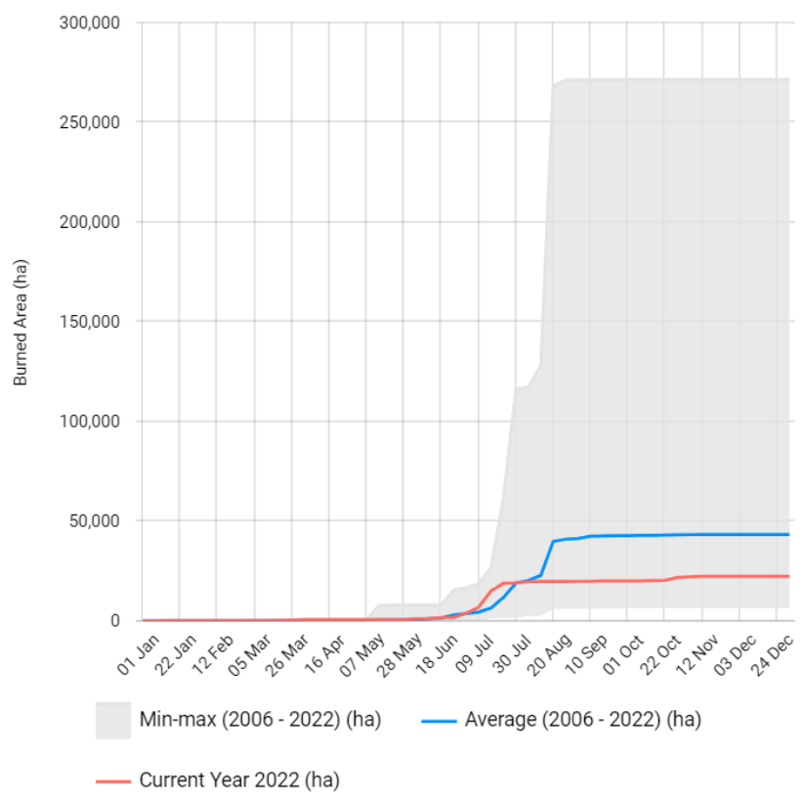
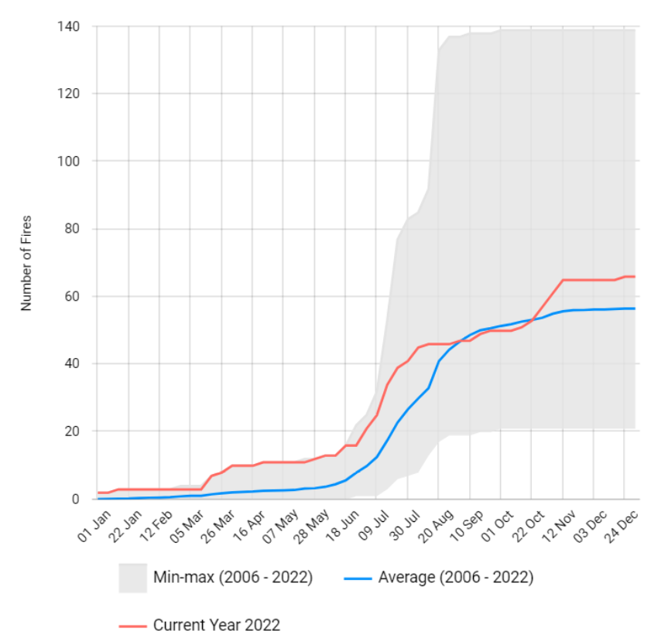
2022 burnt area and number of fires in EL
Greece – 2022 burnt areas and number of fires
Notes:
EL: The total burnt area was around average until end of July. Then, as of August went below average.
EL: The number of wildfires events was slightly above average during almost the whole season (except some days of September and October).

Slide 13
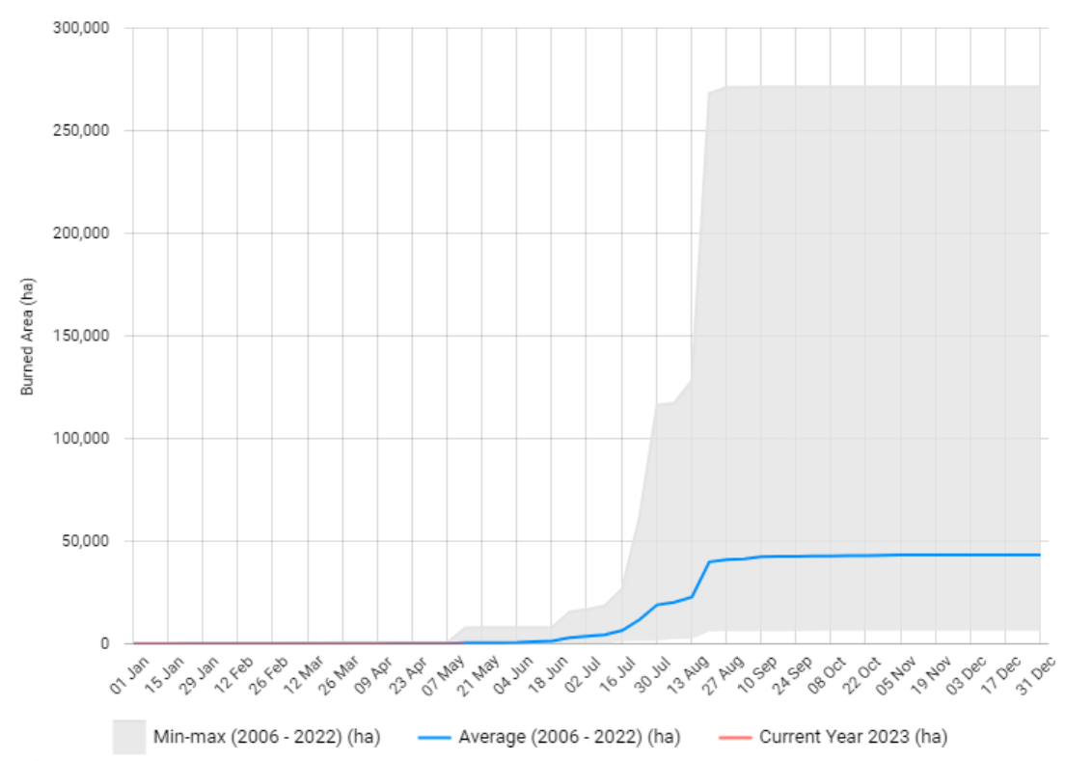
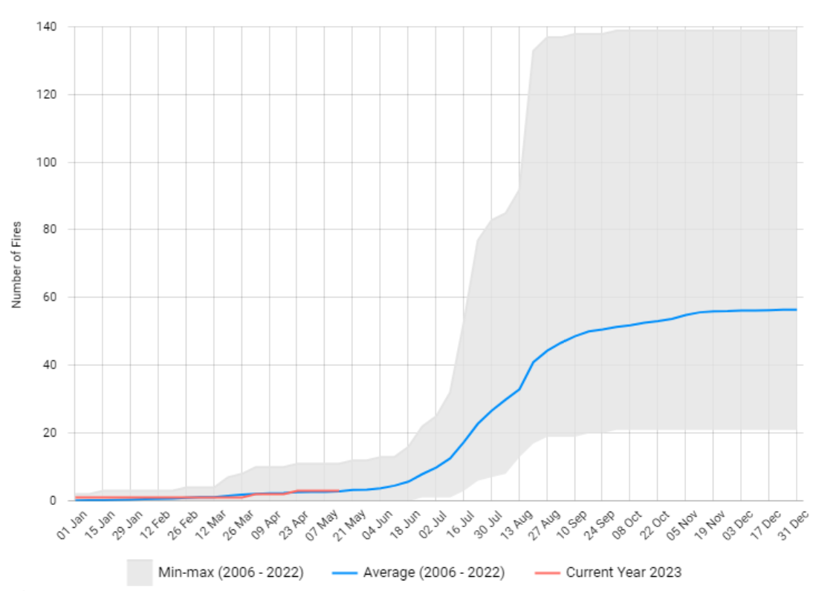
2023 burnt area and number of fires in EL
Greece – 2023 (until 14 May) burnt areas and number of fires)
Notes:
EL: Until 14 May, the total burnt area and the number of wildfire events are around average.

Slide 14
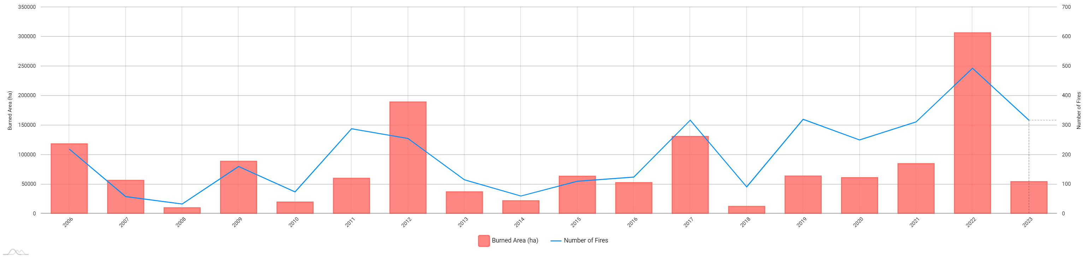
Burnt areas and number of fires in ES

Slide 15
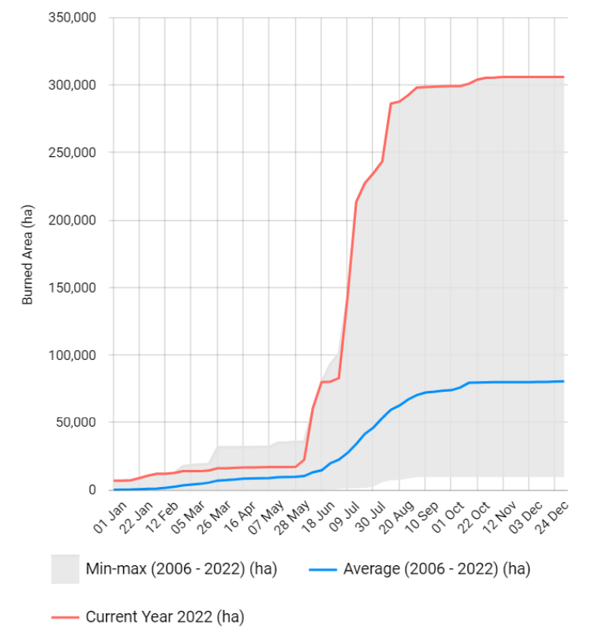
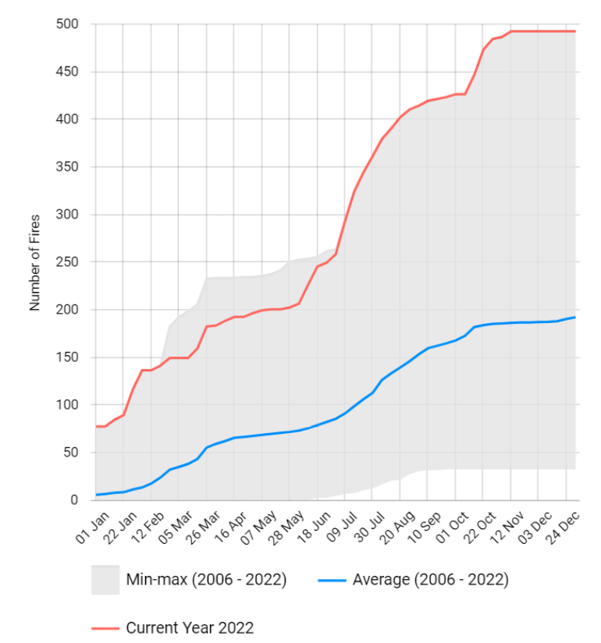
2022 burnt area and number of fires in ES
Spain – 2022 burnt areas and number of fires
Notes:
ES: Following the general trend it was experienced far above average burnt areas and number of fires in 2022. Actually, it was the worst year in terms of burnt areas and number of fires since 2006.

Slide 16
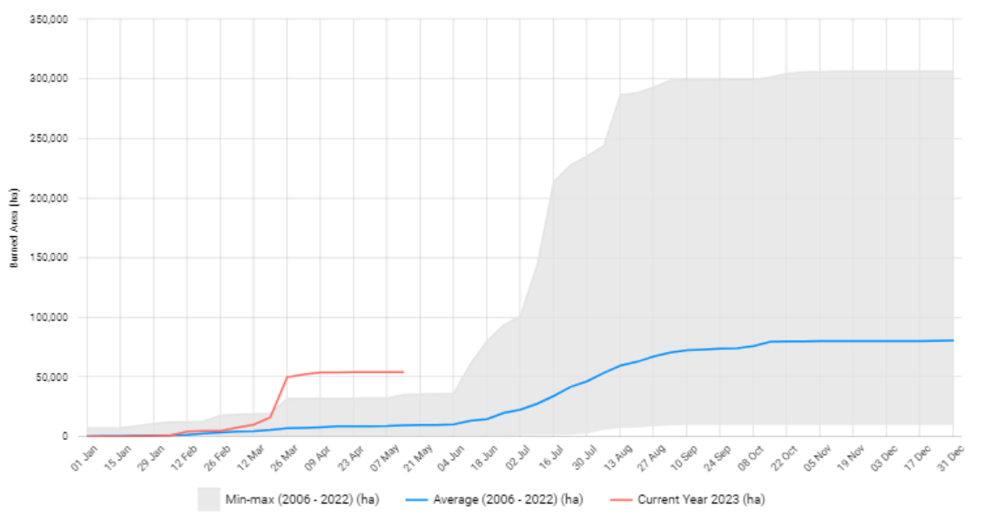
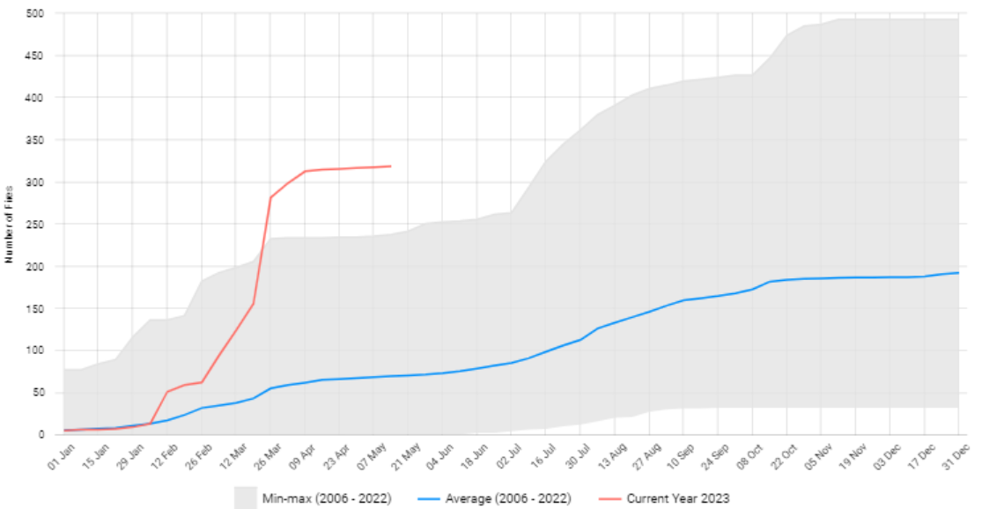
2023 burnt area and number of fires in ES
Spain – 2023 (until 14 May) burnt areas and number of fires
Notes:
ES: From 1 January until end of February, the total burnt area was around the average. From March until 14 May, the total burn areas is above average (even reaching record values for this time period).
ES: In January, the total number of wildfire events was around the average. From 1 February until 14 May, the total number of wildfire events was above average (even reaching record values for this time period).

Slide 17
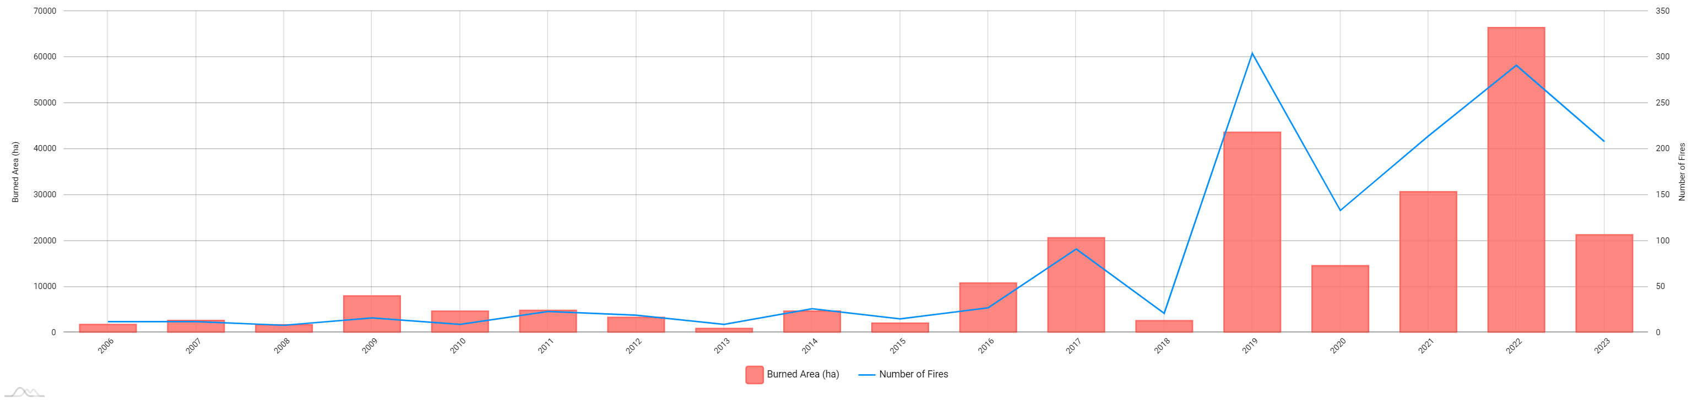
Burnt areas and number of fires in FR

Slide 18
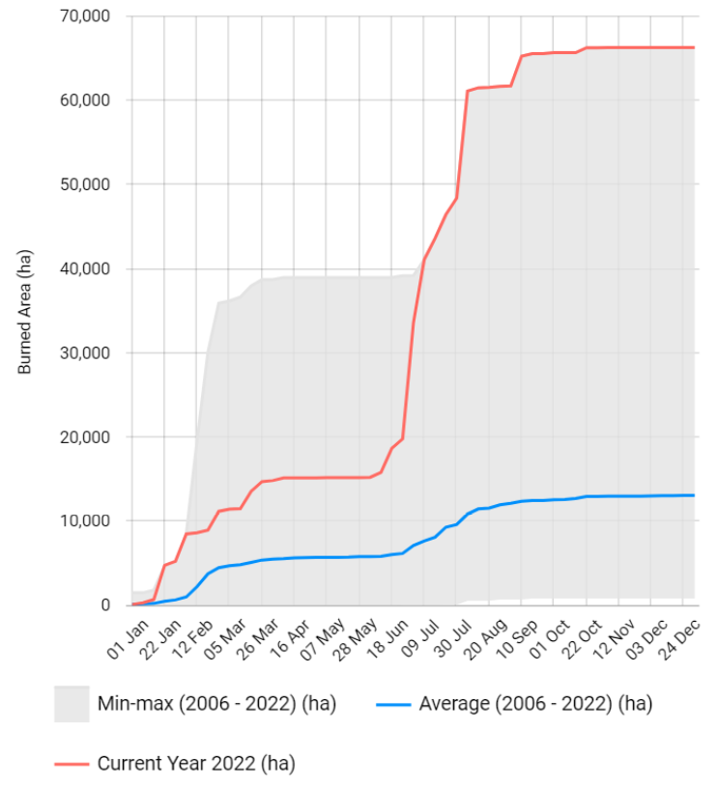
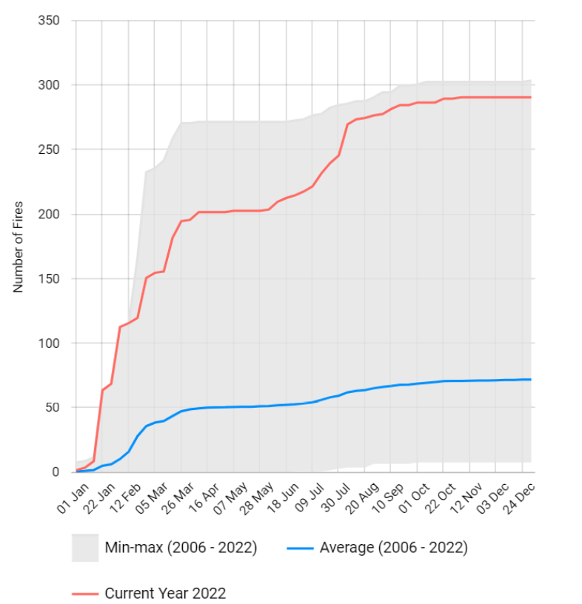
2022 burnt area and number of fires in FR
France – 2022 burnt areas and number of fires
Notes:
FR: Following the general trend, it was experienced far above average burnt areas and number of fires in 2022. Actually, it was the worst year in terms of burnt areas since 2006.

Slide 19
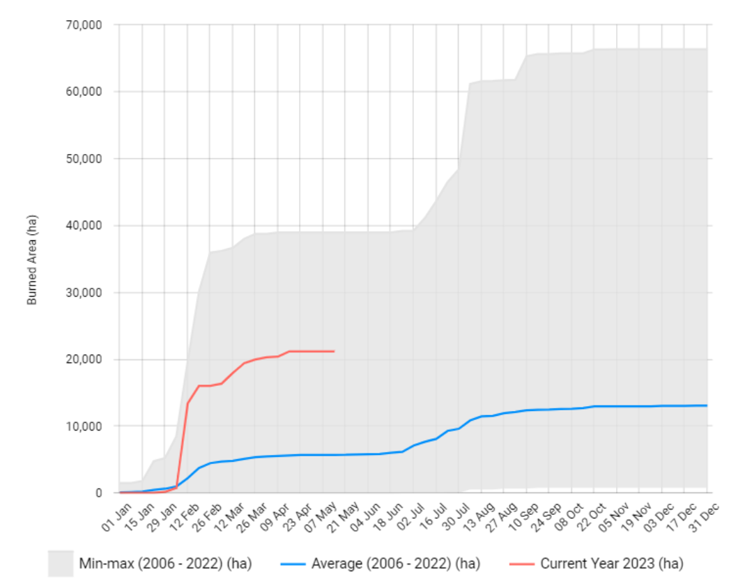
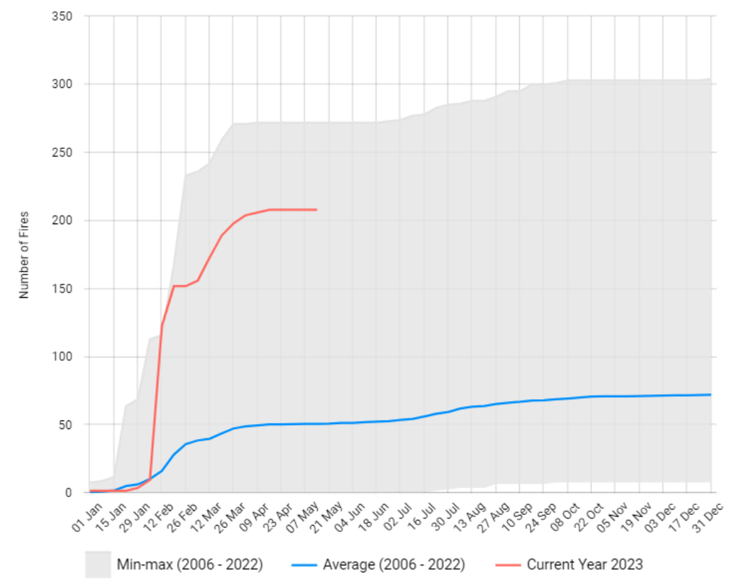
2023 burnt area and number of fires in FR
France – 2023 (until 14 May) burnt areas and number of fires
Notes:
FR: In January, the total burnt area was around the average. From February until 14 May, the total burn areas is above average.
FR: In January, the total number of wildfire events was around the average. From 1 February until 14 May, the total number of wildfire events was above average.

Slide 20
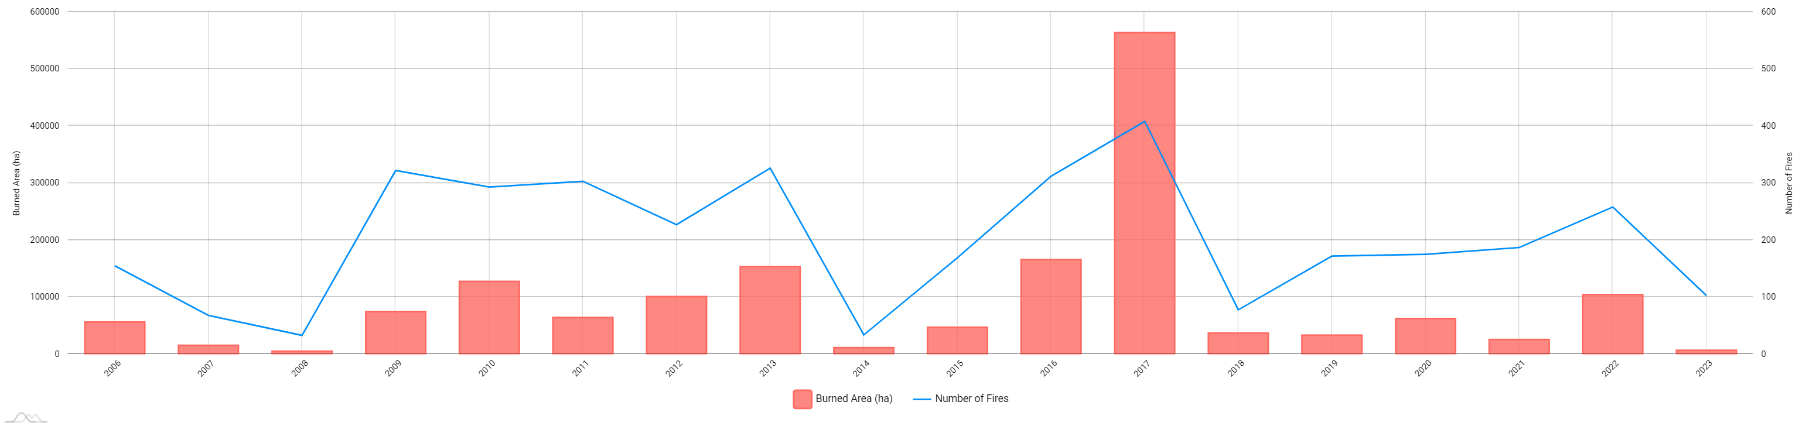
Burnt areas and number of fires in PT

Slide 21
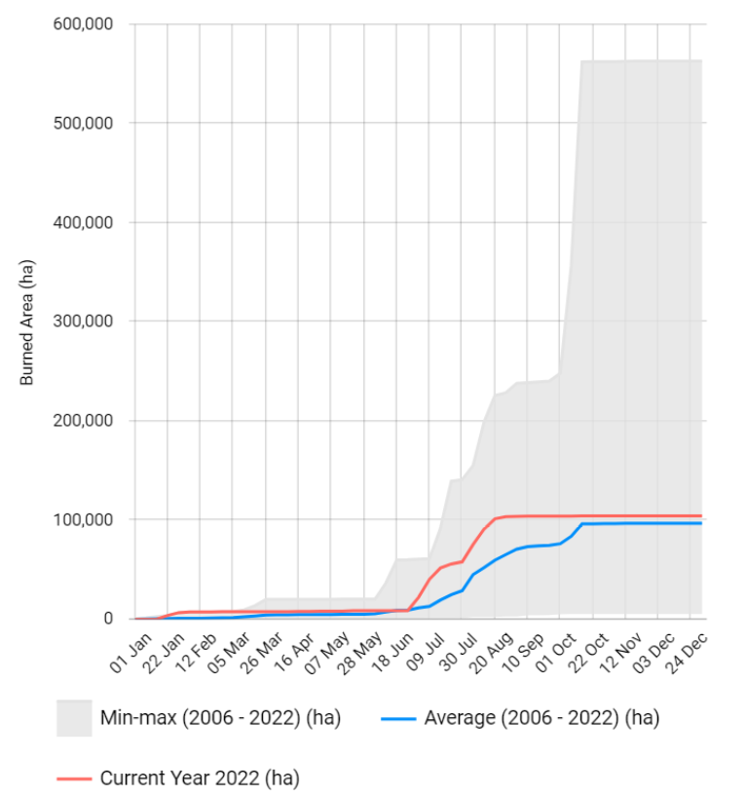
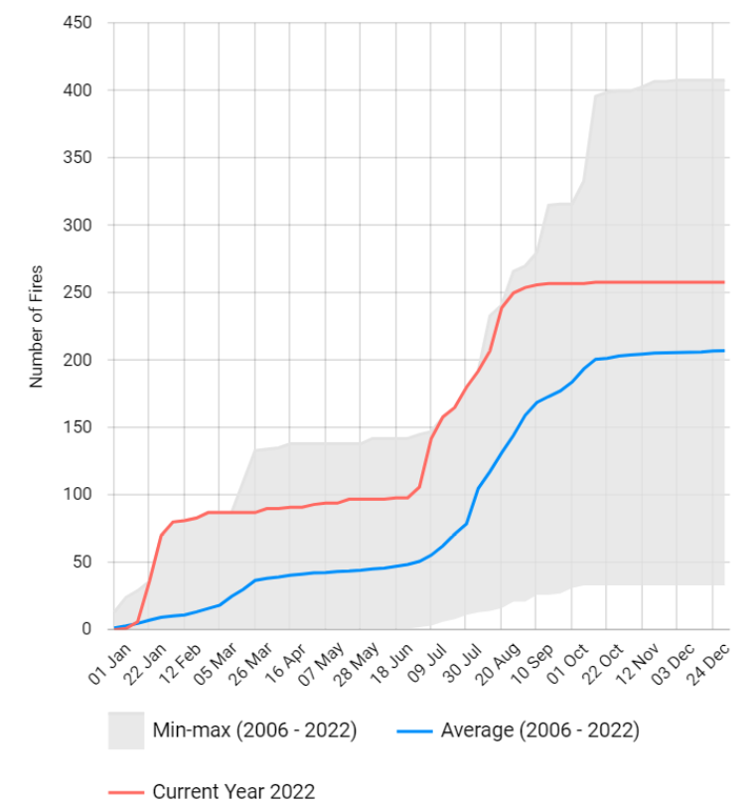
2022 burnt area and number of fires in PT
Portugal – 2022 burnt areas and number of fires
Notes:
PT: The total burnt area was around average until end of June. Then, as of July went above average.
PT: The number of wildfires events was above average during almost the whole season (except few days beginning of January).

Slide 22
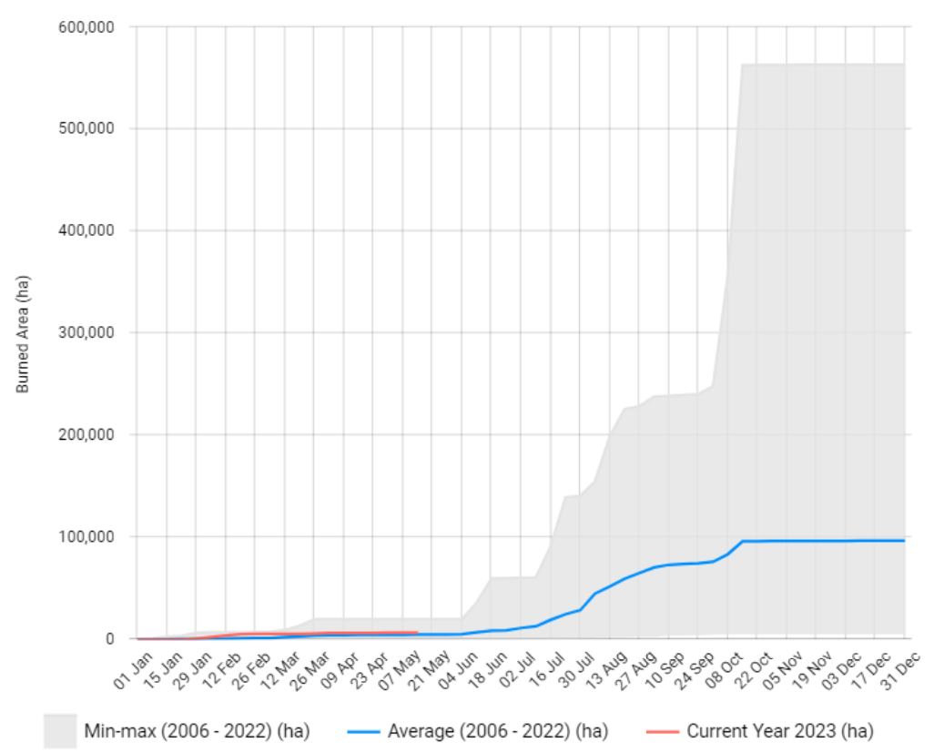
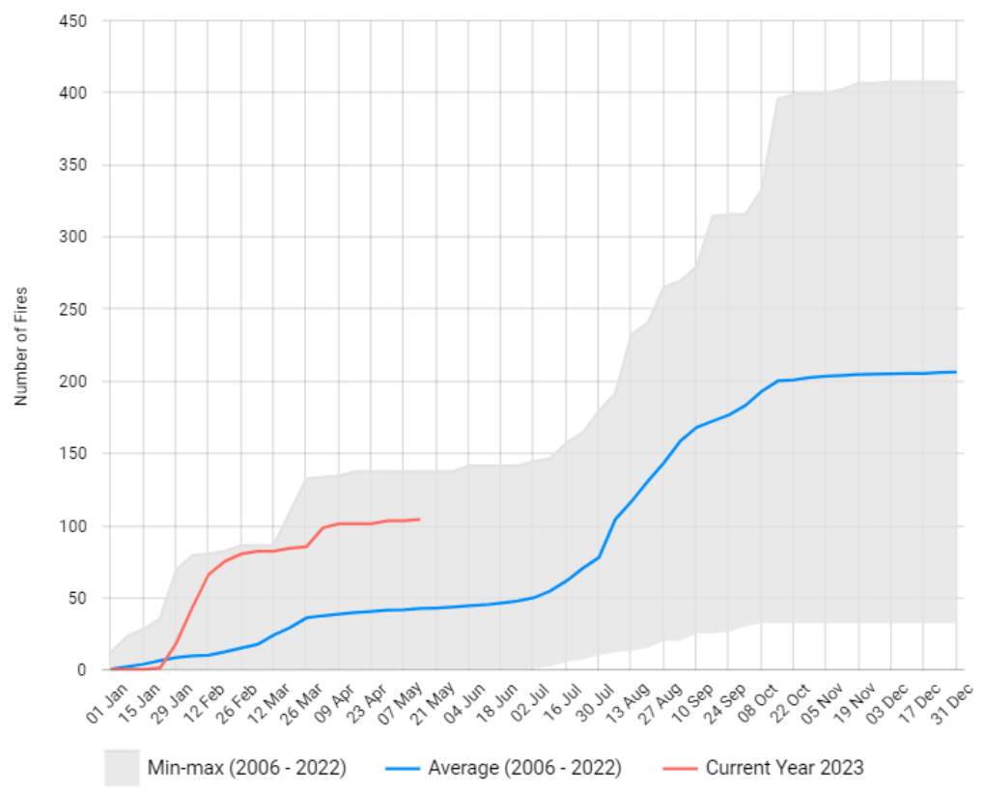
2023 burnt area and number of fires in PT
Portugal – 2023 (until 14 May) burnt areas and number of fires
Notes:
PT: Until 14 May, the total burnt area was around the average.
PT: Until 14 May, the total number of wildfire events was above average (except few days in January)

Slide 23
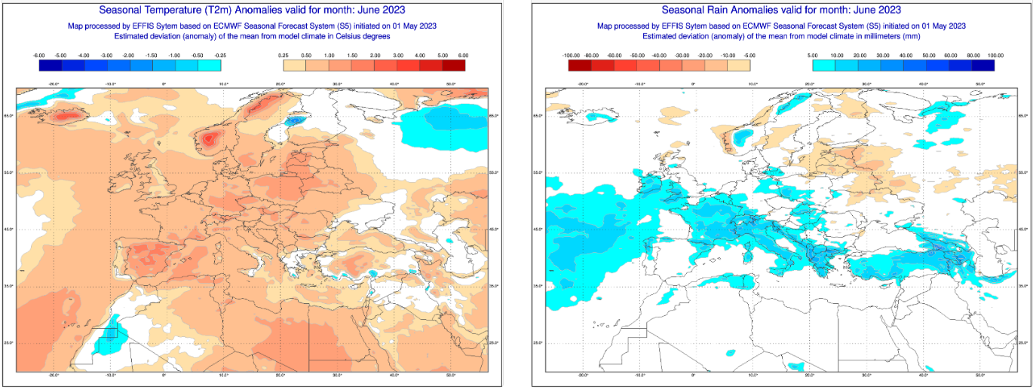
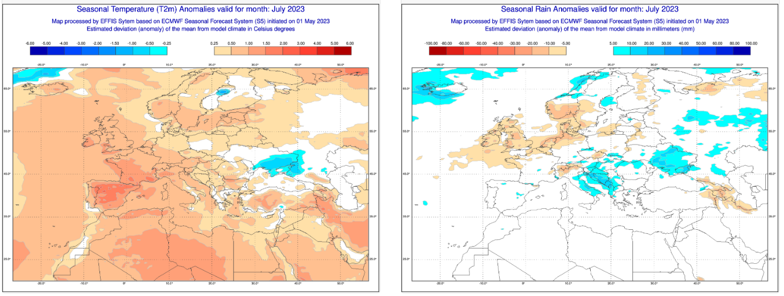
2023 season – Temperature and rain anomalies
Seasonal Forecast of Temperatures and Rain Anomalies, June – July 2023.

Slide 24
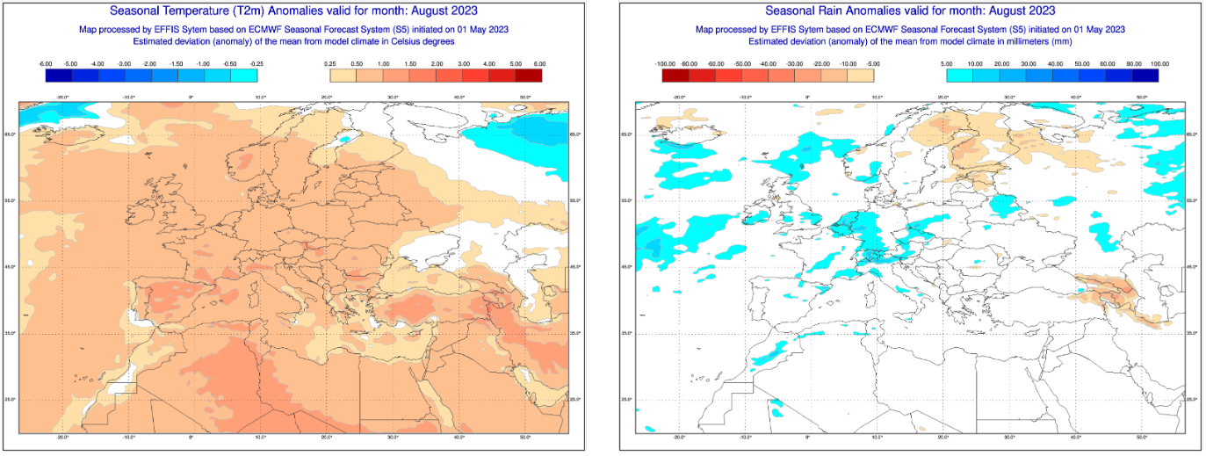
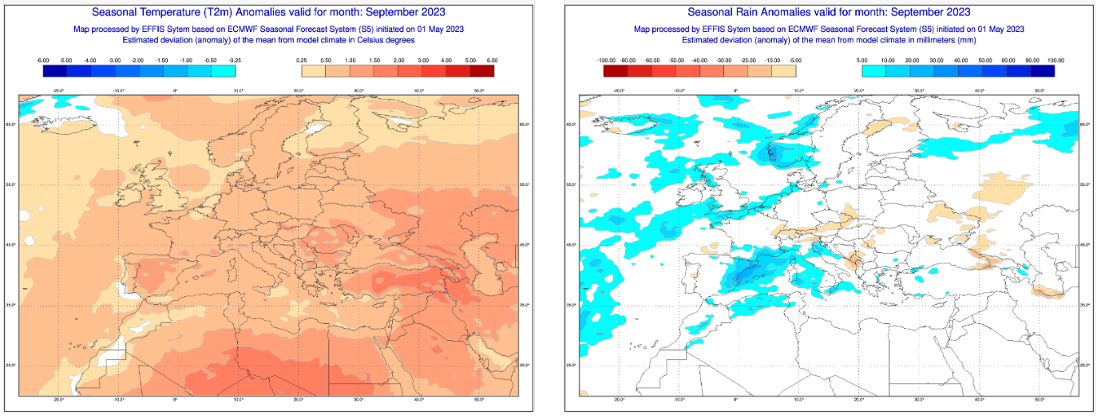
2023 season – Temperature and rain anomalies
Seasonal Forecast of Temperatures and Rain Anomalies, August – September 2023.
Notes:
2023 could be again a challenging season:
Above average temperatures are foreseen in most of the European continent
In terms of precipitation, the seasonal forecast indicates geographically and temporally different situations (e.g. dryer conditions in the Iberian Peninsula and north east Europe in May and wetter conditions in southern Europe in June).

Slide 25
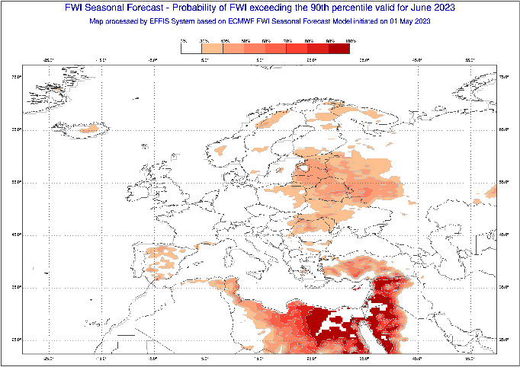
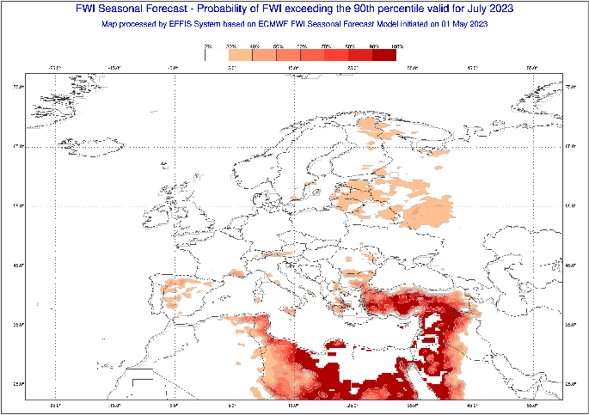
2023 season - Fire Weather Index (FWI)
Notes:
After a dry season in Europe in 2022, there are persistent drought conditions in the beginning
of 2023.
Based on the last 40 years data, there is a moderate to high probability for areas in
north eastern and south eastern Europe, to experience much higher than average Fire Weather Index (FWI) notably from June to September.
To be noted that, with a high value of FWI there is a high probability of having larger wildfires and burnt areas

Slide 26
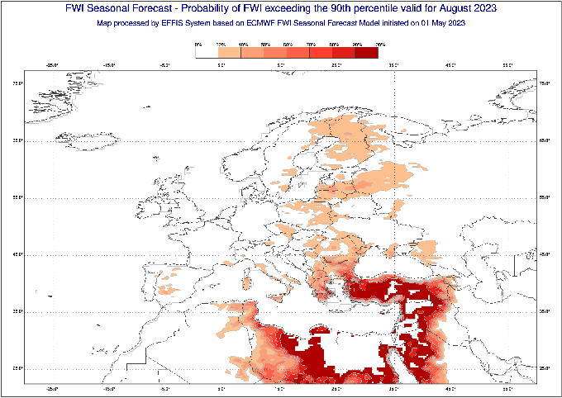
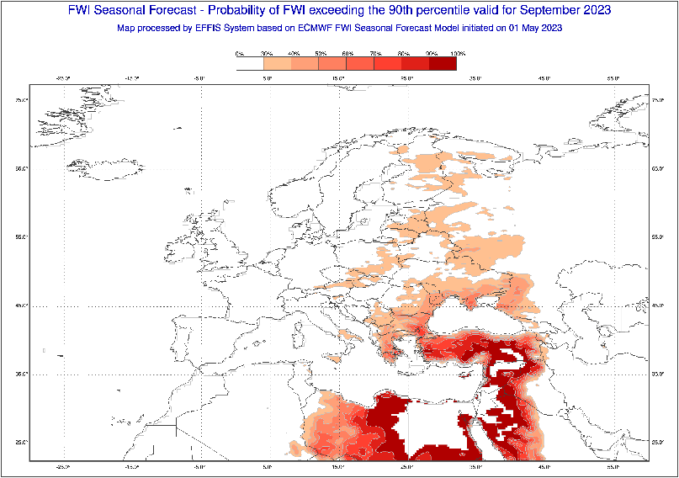
2023 season - Fire Weather Index (FWI)

Slide 27
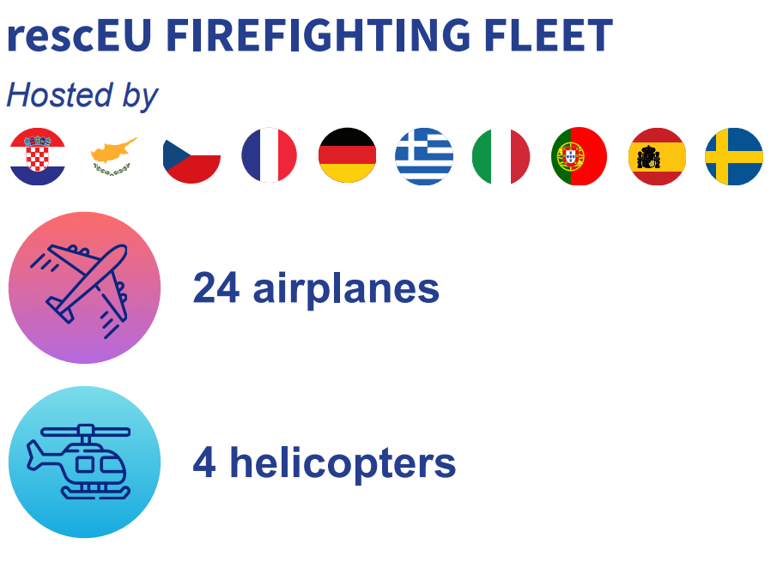

Slide 28
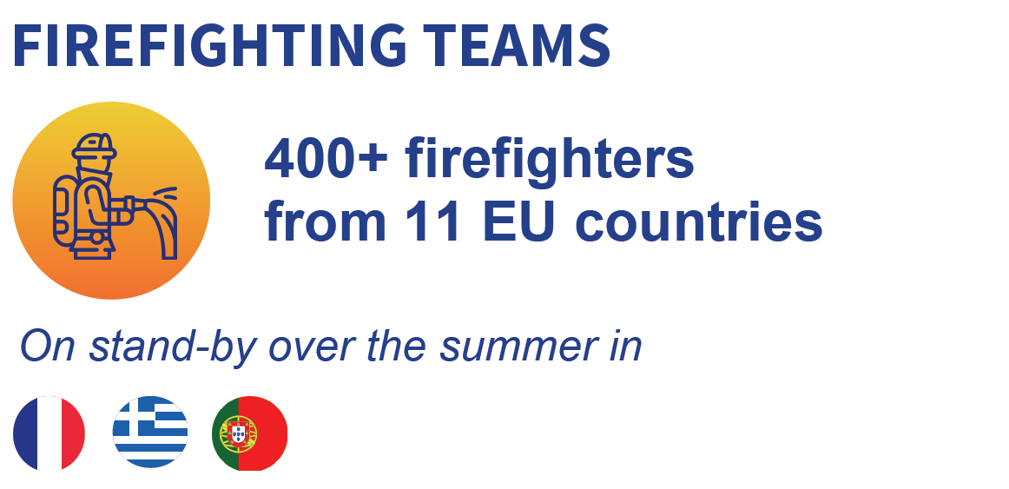

Slide 29
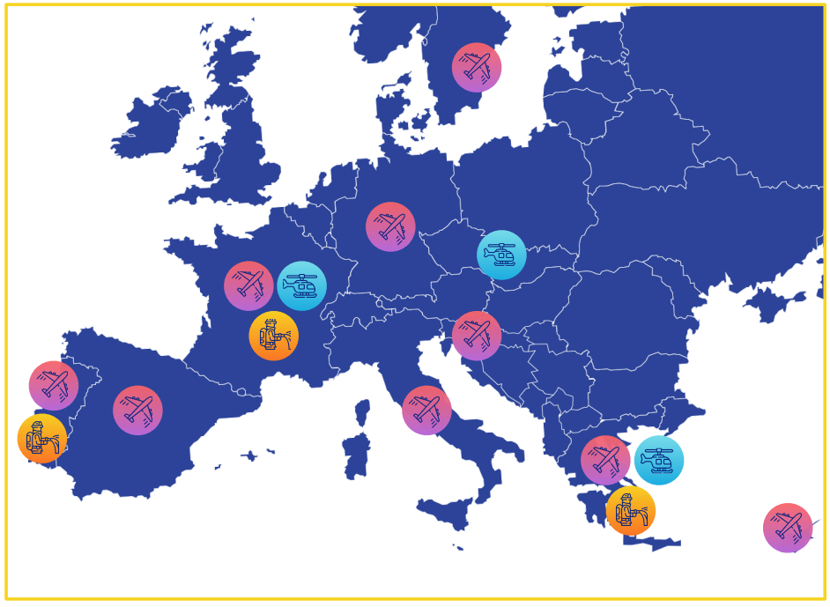

Slide 30
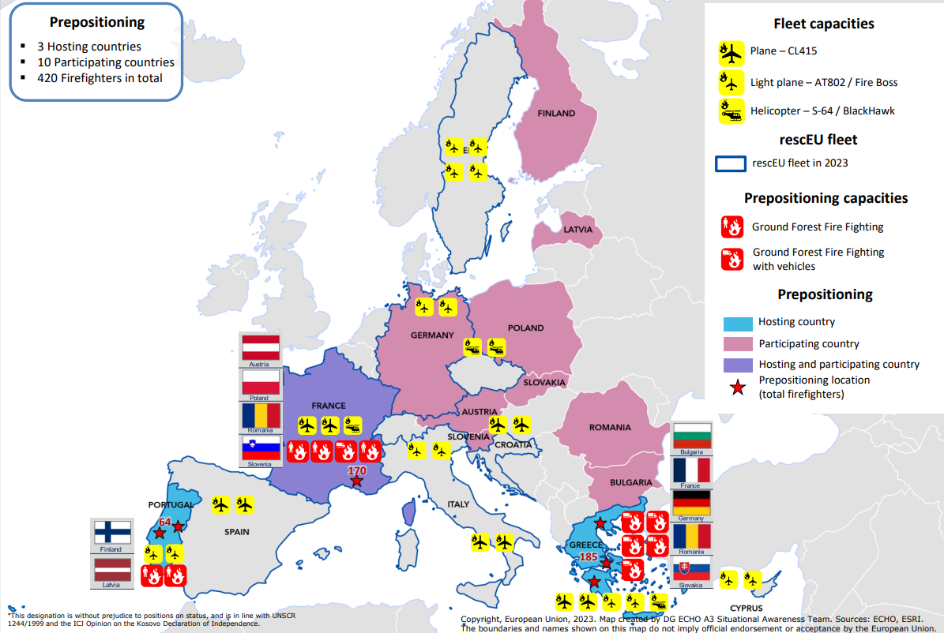

Slide 31
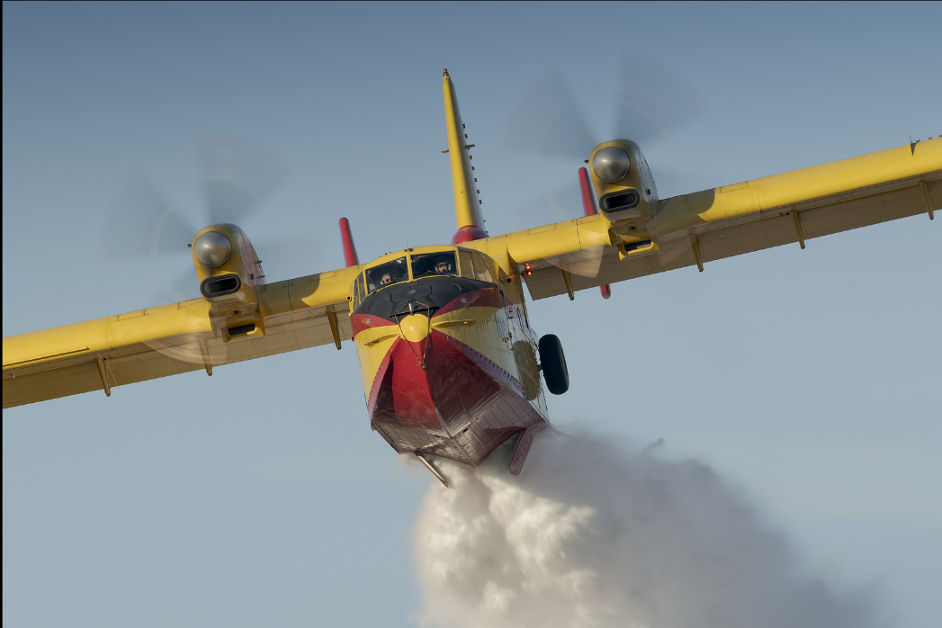
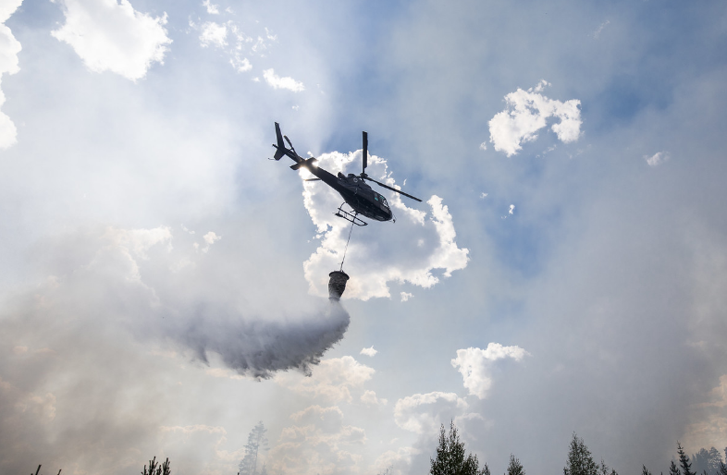
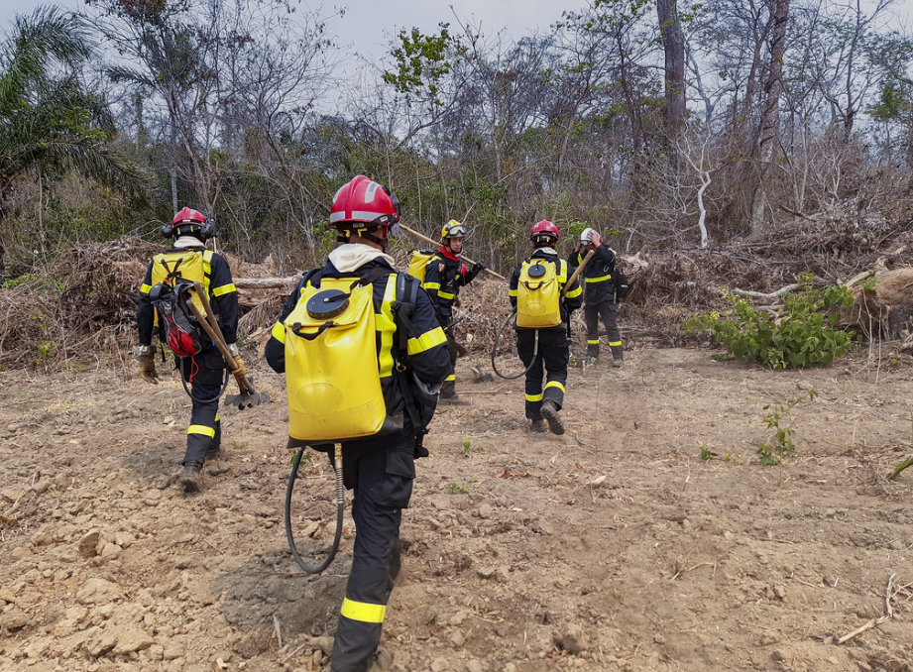
FRANCE
- 2 Canadair airplanes + 1 helicopter in the rescEU fleet
Hosting 174 prepositioned firefighters (July-August, from Austria, Poland, Romania, Slovenia)
Sending 20 prepositioned firefighters to Greece

Slide 32
GREECE
- 2 Canadair airplanes + 2 light airplanes +
1 helicopter in the rescEU fleet
Hosting 205 prepositioned firefighters (July-August, from Romania, France, Germany, Bulgaria, Malta, Slovakia)

Slide 33
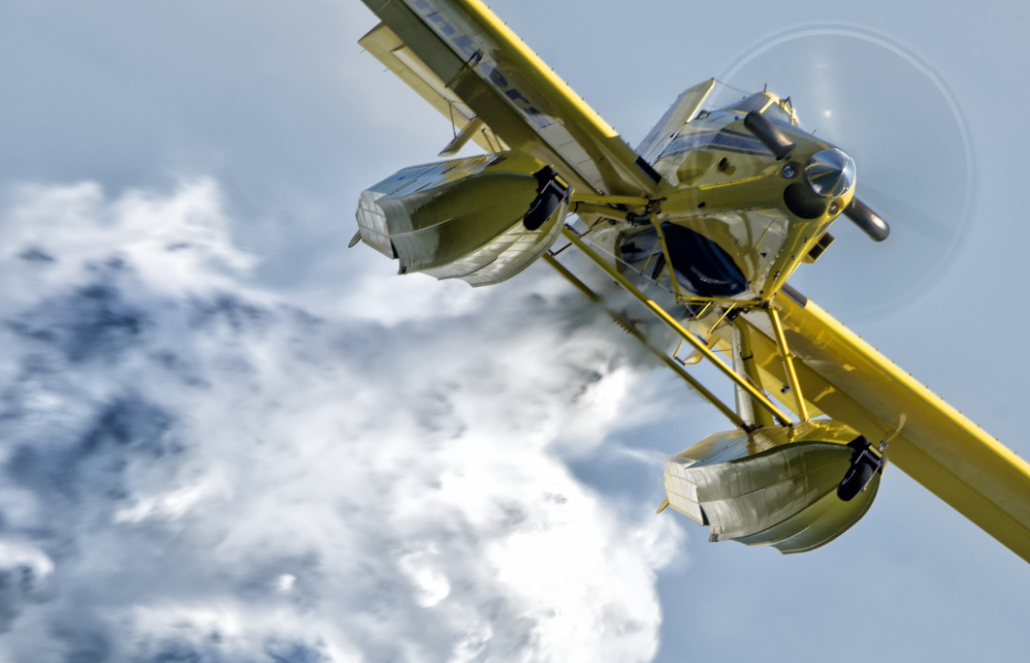
PORTUGAL
- 2 light airplanes in the rescEU fleet
Hosting 60 prepositioned firefighters (August-September, from Finland, Latvia, Norway)

Slide 34
GERMANY
- 2 light airplanes in the rescEU fleet
Sending 20 prepositioned firefighters to Greece

Slide 35
SPAIN
2 Canadair airplanes in the rescEU fleet

Slide 36
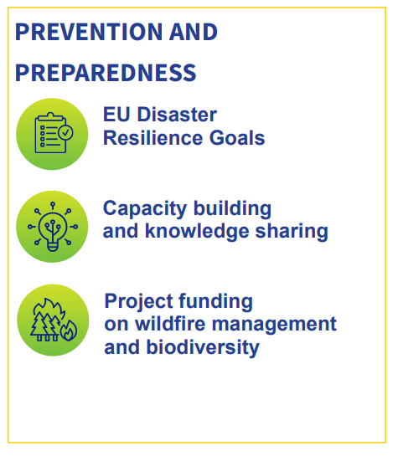
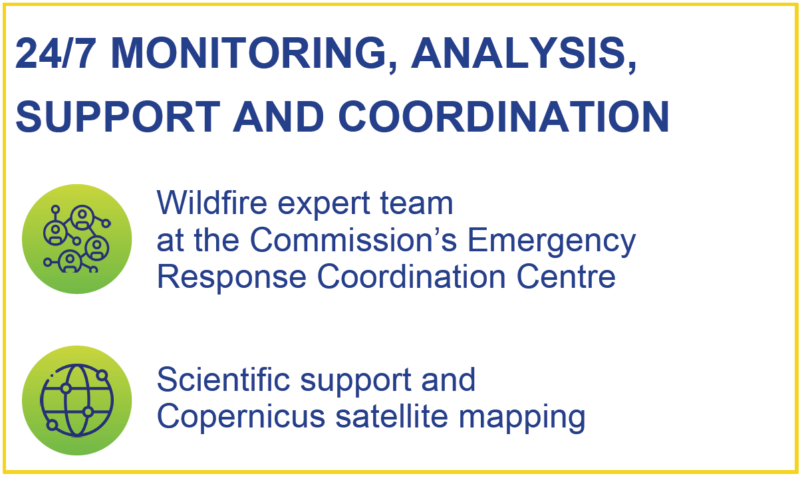

Slide 37

Wildfire peer review
Notes:
On 30 May the Commission launched a new tool to support wildfire risk management capacity building and good practices exchange among European countries. The Wildfire Peer Review Assessment Framework (PRAF) will facilitate peer reviews of wildfire risk management systems within the framework of the Union Civil Protection Mechanism (UCPM). This new tool will help countries assess their capacity to prevent wildfires from starting and their preparedness to cope with them. Member States and Participating States are invited to volunteer for a wildfire management peer review or to use this tool for a self-review, at national and/or regional level.

Slide 38



More information
ec.europa.eu/echo
@ec.humanitarian.aid
@eu_echo
EU Civil Protection
& Humanitarian Aid
Operations

Slide 39

Thank you
© European Union 2023
Unless otherwise noted the reuse of this presentation is authorised under the CC BY 4.0 license. For any use or reproduction of elements that are not owned by the EU, permission may need to be sought directly from the respective right holders.
Notes:
Update/add/delete parts of the copy right notice where appropriate.
More information: https://myintracomm.ec.europa.eu/corp/intellectual-property/Documents/2019_Reuse-guidelines%28CC-BY%29.pdf

